Slide 1
R Projects and RMarkdown
AACC University 2020
Shannon Haymond, PhD

Slide 2
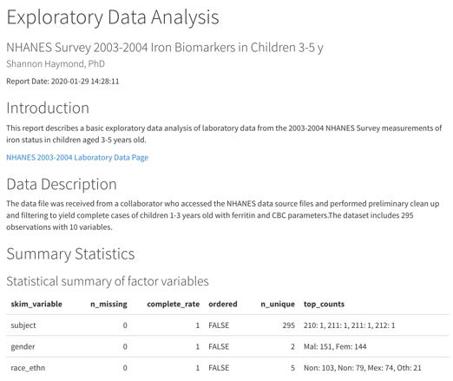
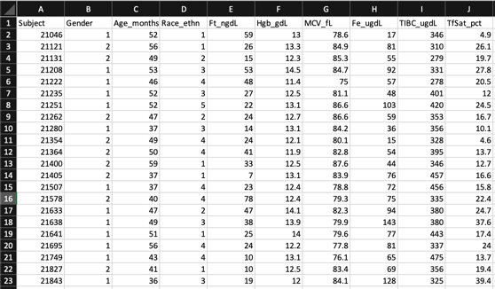
A familiar scenario?
?
Notes:
What do people use for analyzing, visualizing and communicating data?

Slide 3
Is your analysis reproducible?
Are the steps transparent?
Can you automate the process?
Can you scale the process?
Is the process organized?

Slide 4


There’s a better way!
R Notebooks
R Projects
Notes:
Last but not least, your computing results will be more likely to be reproducible if you use R Markdown (or other knitr-based source documents), compared to the manual cut-and-paste approach. This is because the results are dynamically generated from computer source code. If anything goes wrong or needs to be updated, you can simply fix or update the source code, compile the document again, and the results will automatically updated. You can enjoy reproducibility and convenience at the same time.

Slide 5
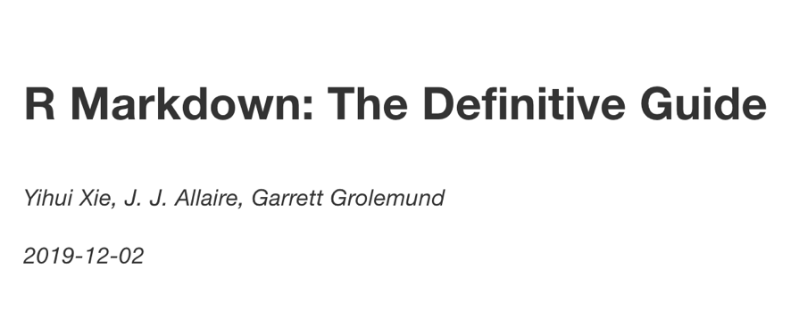
https://bookdown.org/yihui/rmarkdown/
Great resource!

Slide 6
What is R Markdown?
R Markdown is an R package and a set of tools that are deeply embedded in RStudio
Specific authoring format that enables documents that combine text, R code, and the output from that code (tables, graphics, etc) in a way that is best for human understanding – facilitates literate programming
Any R Markdown document can be used as a Notebook
Notes:
R Notebooks are an implementation of Literate Programming that allows for direct interaction with R while producing a reproducible document with publication-quality output.
Any R Markdown document can be used as a notebook, and all R Notebooks can be rendered to other R Markdown document types. A notebook can therefore be thought of as a special execution mode for R Markdown documents. The immediacy of notebook mode makes it a good choice while authoring the R Markdown document and iterating on code. When you are ready to publish the document, you can share the notebook directly, or render it to a publication format with the Knit button.

Slide 7
What is an R Notebook?
Notebooks are a special execution mode for R Markdown documents with chunks that can be executed independently and interactively, with output visible immediately beneath the input and Viewer tab – great for iterating code.
By default, R Markdown enables inline output (notebook) mode
All R Notebooks can be rendered to other R Markdown document types
Notes:
R Notebooks are an implementation of Literate Programming that allows for direct interaction with R while producing a reproducible document with publication-quality output.
Any R Markdown document can be used as a notebook, and all R Notebooks can be rendered to other R Markdown document types. A notebook can therefore be thought of as a special execution mode for R Markdown documents. The immediacy of notebook mode makes it a good choice while authoring the R Markdown document and iterating on code. When you are ready to publish the document, you can share the notebook directly, or render it to a publication format with the Knit button.

Slide 8
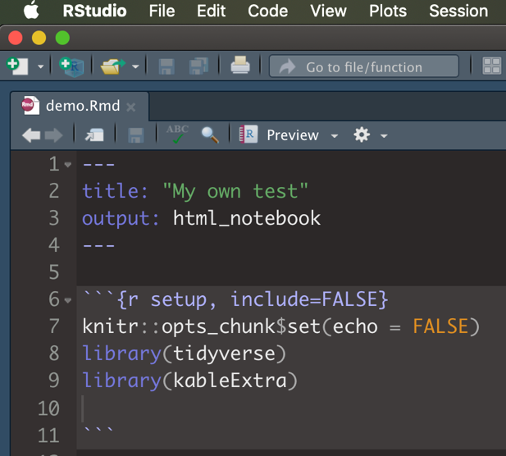
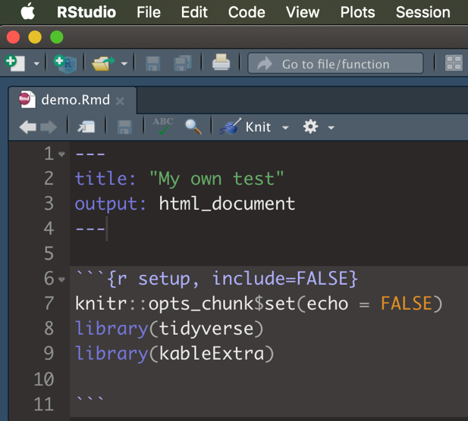
R Notebook
R Markdown

Slide 9
R Projects
A built-in feature in RStudio to help you keep all the files associated with a project together — input data, R scripts, analytical results, figures.
A lifesaver for your future self and collaborators!

Slide 10

What have we learned so far?
Basic understanding of
R vs RStudio – have seen RStudio IDE and some R code
R Markdown/Notebooks
R projects
Let’s put it all together and go through a very simple workflow for taking structured data, performing basic EDA, and generating a shareable report

Slide 11
We’ll use 3 steps
Organize
Analyze
Render
R Project
R Notebook
R Notebook

Slide 12
1.
Organize
Let’s start by creating an R Project for this analysis

Slide 13
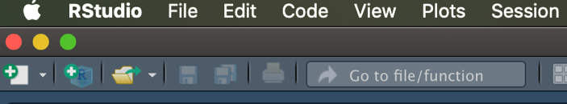
1. Use New Project button on toolbar 2. Use New Project command from File tab
Create a Project

Slide 14
What happens in RStudio?
Creates a project file (.Rproj extension) within project directory
Creates hidden directory for project-specific temporary files
A new R session is started
The current working directory is set to the project directory
Loads in whatever was there prior – if options indicate
Loads the project and displays name in Projects toolbar.
Notes:
Creates a project file (with an .Rproj extension) within the project directory.
Creates a hidden directory (named .Rproj.user) where project-specific temporary files (e.g. auto-saved source documents, window-state, etc.) are stored.
Loads the project into RStudio and display its name in the Projects toolbar (which is located on the far right side of the main toolbar)

Slide 15
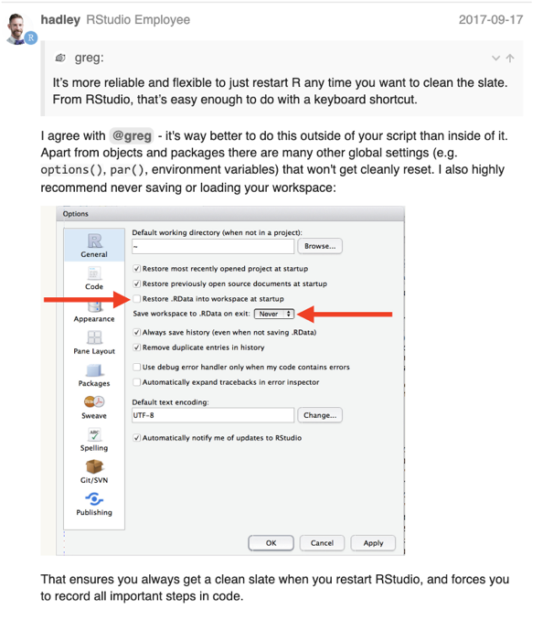
Start each R session with a fresh environment!

Slide 16
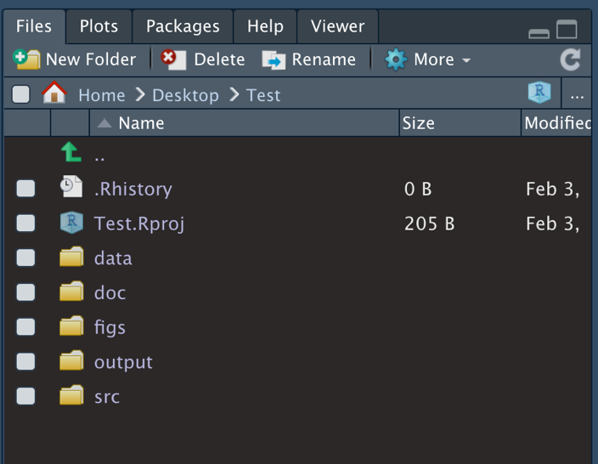
Within RStudio
Set up file system
Now all files for this project are together and organized
Notes:
Data – keep raw data input files here
Src – keep your R scripts here
Outputs – save tables, or processed data here
Figs – save plots and visuals here
Docs – references, other files

Slide 17
2.
Analyze/Summarize
Next, we’ll use R Notebook to analyze/summarize data

Slide 18
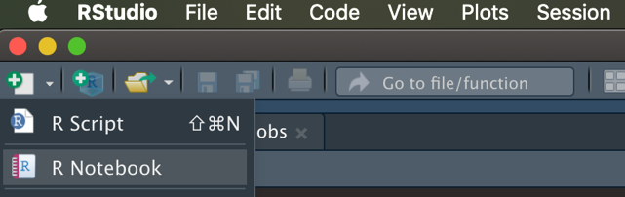
1. Use New File >> R Notebook button on toolbar 2. Use New File >> R Notebook command from File tab
Create new R Notebook

Slide 19
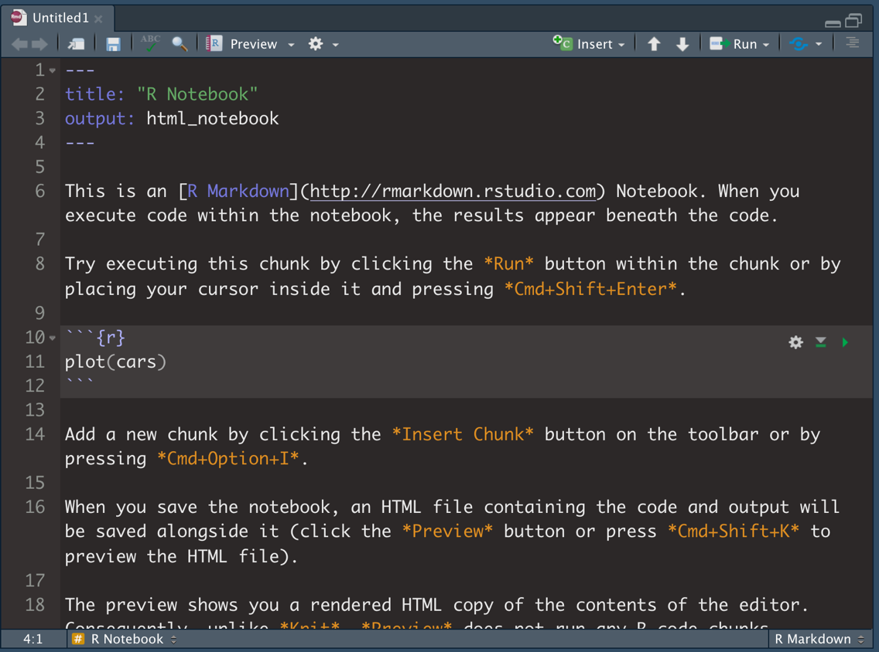
Text with formatting and hyperlinks
YAML
R code chunk
Notes:
Note R code chunk syntax and shortcut

Slide 20

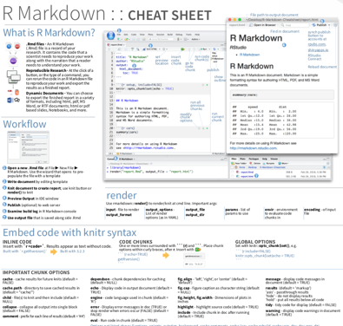
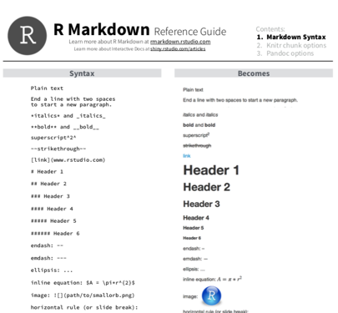
More great resources!

Slide 21
Customize the output using the YAML
Change the YAML title to your own title
Add a YAML option for author
Hint: see page 4 of RMarkdown Reference Guide

Slide 22
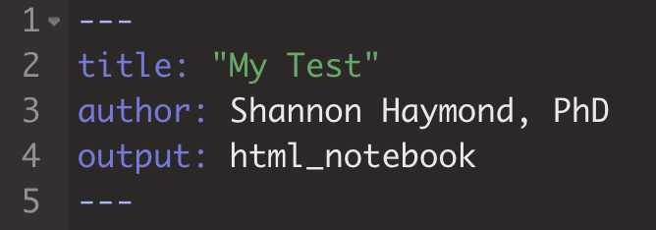

Slide 23
Create a new code chunk to define the setup options.
Label the chunk, tell R what to do with the chunk when rendering
Set options for the document
Load necessary packages
Execute your code.
Setup chunk goes at the top, so it runs first!

Slide 24
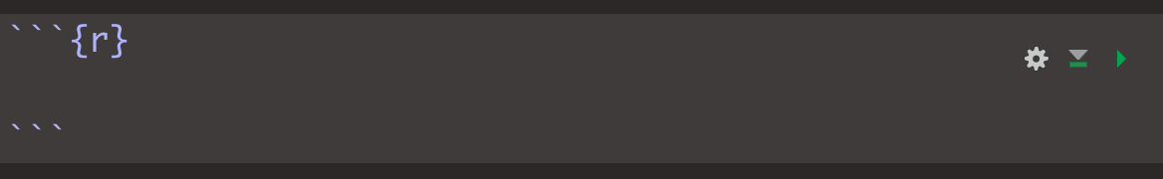
Add a new code chunk
Note syntax for R chunk
New chunk:
*Insert Chunk* button on the toolbar or by pressing Cmd+Option+I or Ctrl+Alt+I
Execute code:
Press *play* button to run entire chunk or select and press Cmd+Enter or Ctrl+Enter

Slide 25
Code chunk options
How code is evaluated and rendered
How results are displayed
Features of plots
Many others – see https://yihui.org/knitr/options/
All chunk options have defaults – you only need to worry about setting the options if you want to change from default

Slide 26
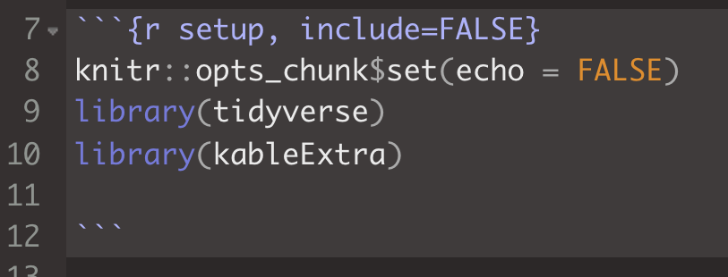
Prevents code and results for this chunk from appearing in the finished file (default = TRUE)
Chunk label
Do not display code in output document (default = TRUE) – here for all chunks

Slide 27
Add your own text and create a new code chunk to read in your data.
Write some text that describes your report.
Create a new code chunk and label it.
Tell R what to do with the chunk when rendering.
Write the code to read in your data.
Execute your code.

Slide 28
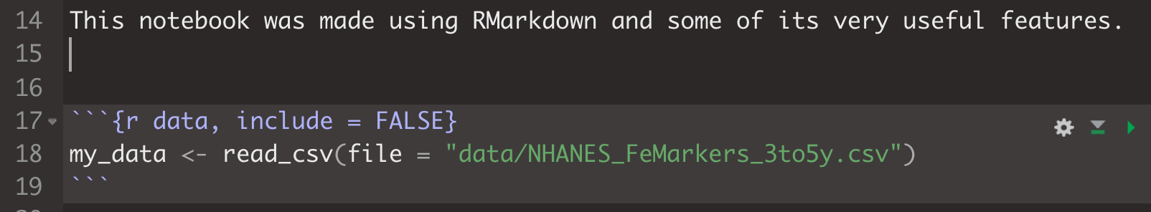

Slide 29
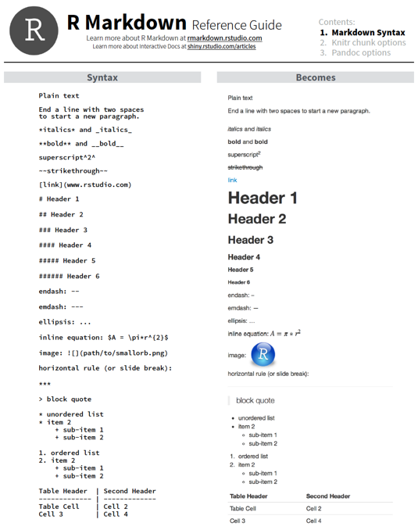
Formatting Text
Inline text formatting requires specific syntax
https://rstudio.com/wp-content/uploads/2015/03/rmarkdown-reference.pdf

Slide 30
Formatting Tables
Requires additional packages/functions
knitr::kable for basic tables
kableExtra for advanced styling
https://cran.r-project.org/web/packages/kableExtra/vignettes/awesome_table_in_html.html

Slide 31
Make a basic stats summary table with a bold title.
Use syntax for text to make the table’s title bold.
Create a new code chunk and label it.
Write the code to create your summary table and format it.
Execute your code.

Slide 32
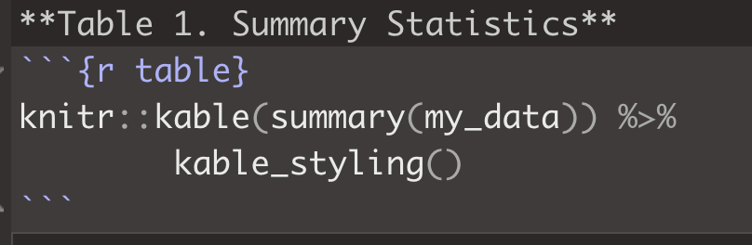
**words** = words
Function call to make the summary stats table
Function calls for styling table

Slide 33
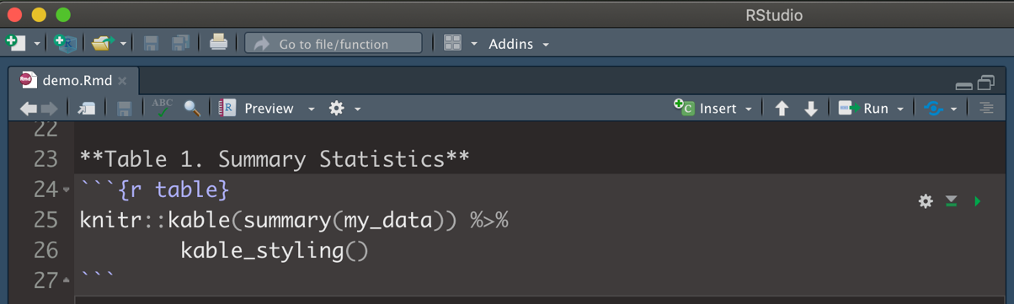
Preview your document
Using an R Notebook allows us to preview the output of our document.

Slide 34
Use syntax to write inline code that summarizes results from the table.
Use inline code syntax to calculate the number of rows in the data table and include this within a sentence.

Slide 35
Inline code syntax:
`r code here`
Use backtick, not single quote!

Slide 36
Create a scatterplot of TfSat_pct and Fe_ugdL with an italicized title.
Use syntax for text to italicize the plot’s title.
Create a new code chunk and label it.
Write the code to create your plot.
Execute your code.

Slide 37
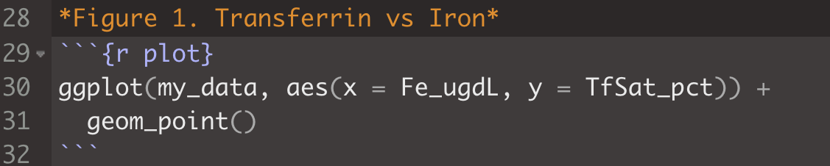
*words* = words
ggplot(data = <DATA>, aes(x = <X_DATA>, y = <Y_DATA>)) +
<GEOM_FUNCTION>

Slide 38
3.
Render
Finally, we’ll format our report and export it

Slide 39
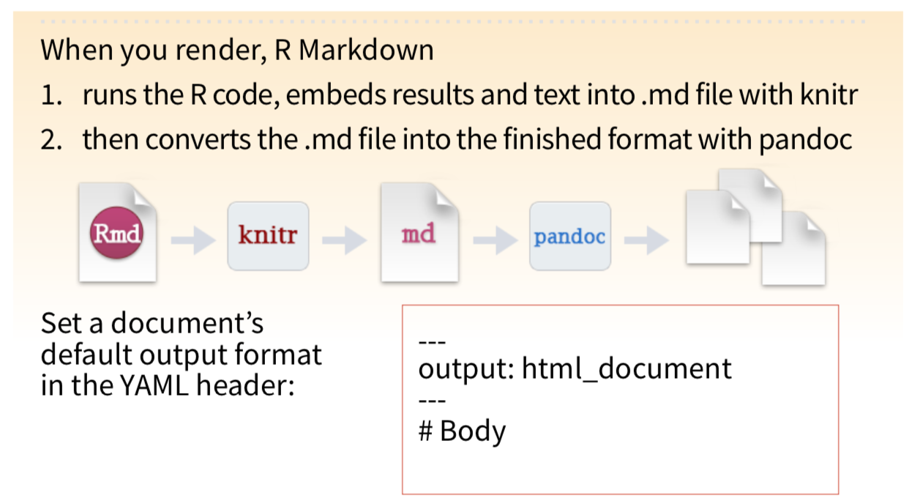

Slide 40
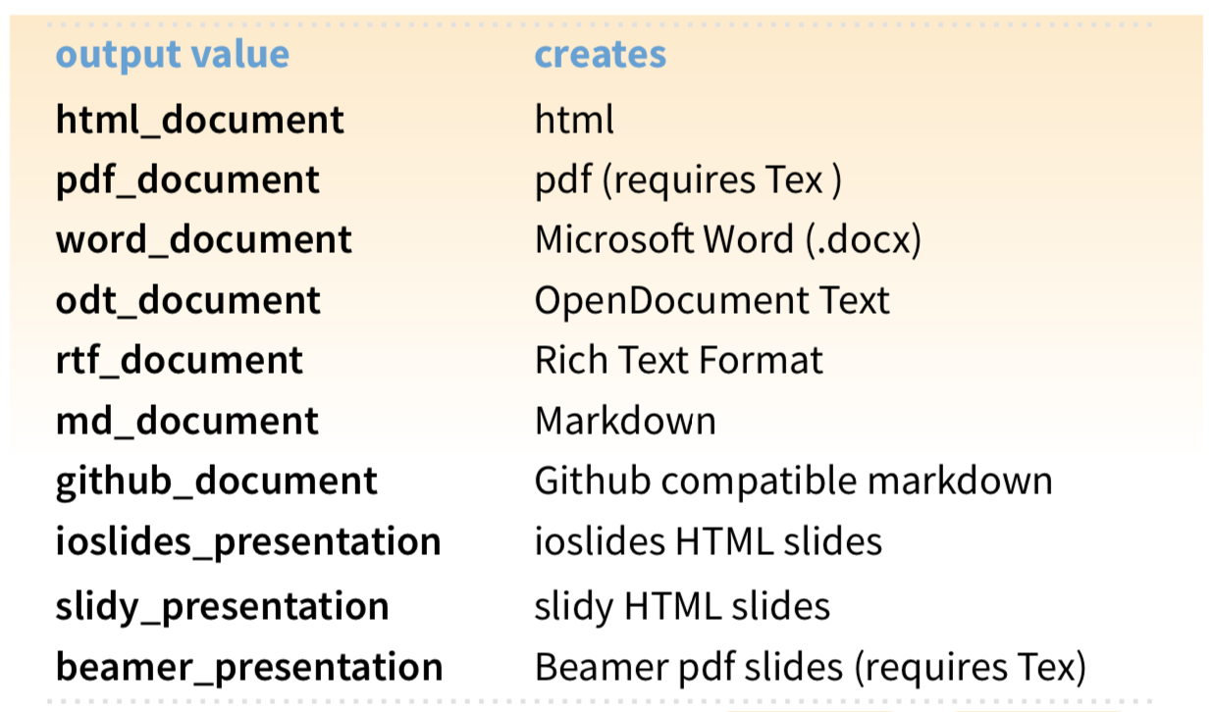

Slide 41
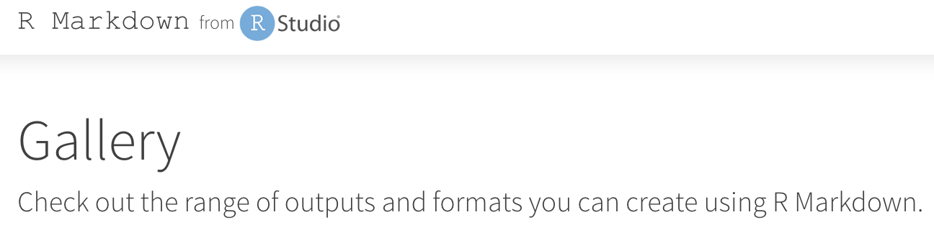
https://rmarkdown.rstudio.com/gallery.html

Slide 42
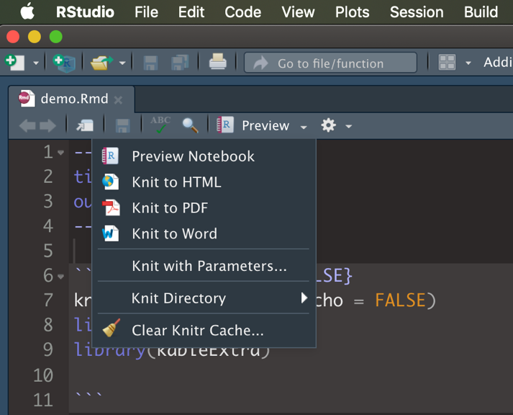
Export our Report

Slide 43
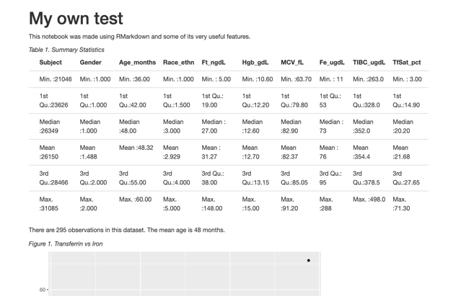
HTML Reports
Place your screenshot here
Customization
Distribution
Interactivity

Slide 44
We did it!
Organize
Analyze
Render
R Project
R Notebook
R Notebook

Slide 45
What’s Next?
Other output formats, customization, and interactivity

Slide 46
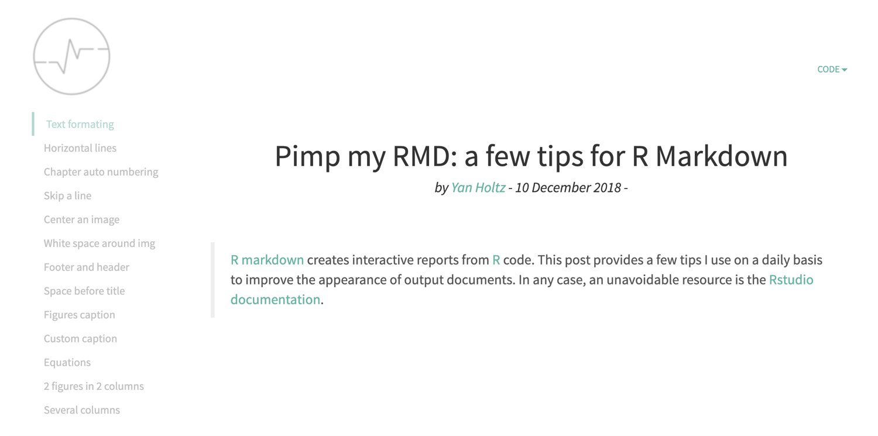
https://holtzy.github.io/Pimp-my-rmd/

Slide 47

https://www.datadreaming.org/post/r-markdown-theme-gallery/

Slide 48
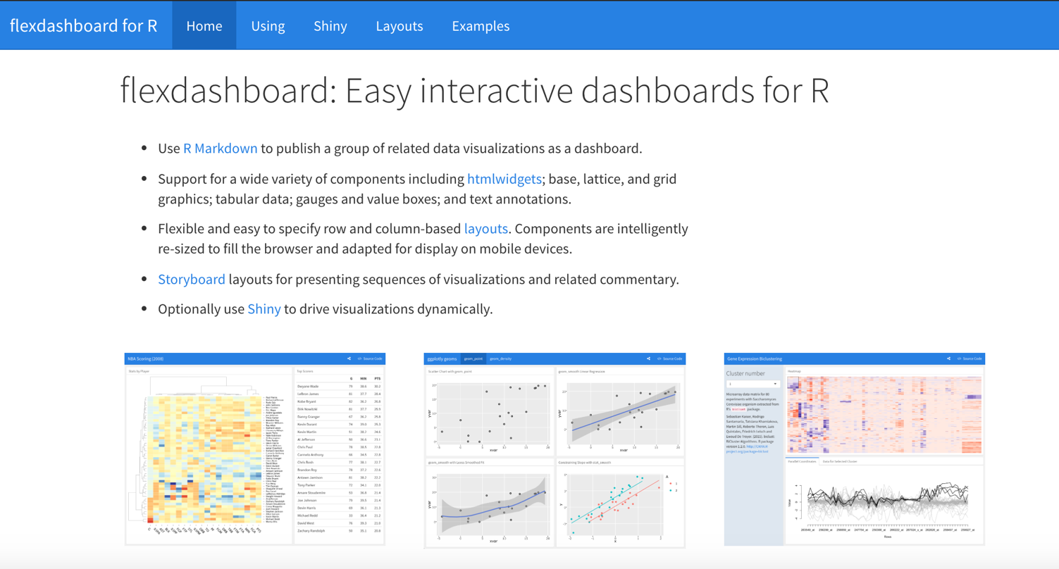
https://rmarkdown.rstudio.com/flexdashboard/

Slide 49

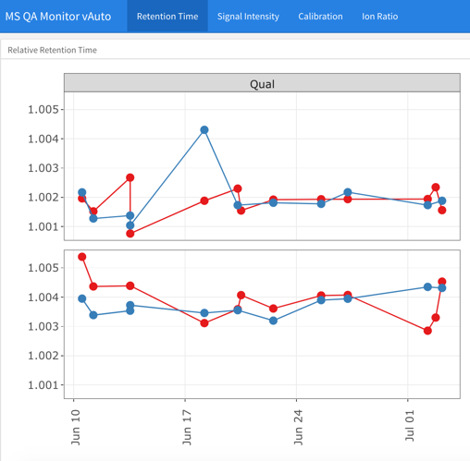
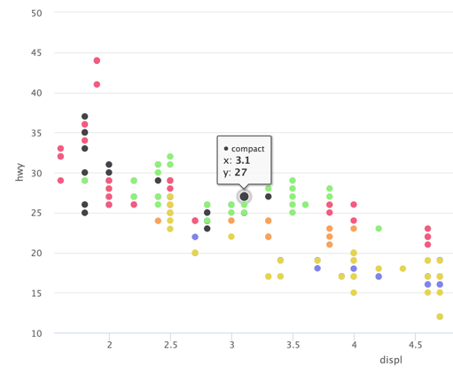
flexdashboard w/
ggplotly
highcharter
cosmos theme

Slide 50
Thanks!
Any questions?
You can find me at:
@SHaymondSays
s-haymond@northwestern.edu
Special thanks to the people who made and released this presentation template for free at SlidesCarnival

